Slide 1

Object Oriented Python
Unit 2 Lab 2

Slide 2
What is OOP?
Object-oriented programming (OOP) is a programming paradigm based on concept of "objects", which can contain data and code: data in the form of fields (often known as attributes or properties), and code, in the form of procedures (often known as methods).
https://en.wikipedia.org/wiki/Object-oriented_programming

Slide 3
Objects are instances of a “class”
Classes are the definitions for an object. An example:
The Dog class has attributes and methods.
Dog Class
name - string age - int weight - int breed - string
bark() eat() sleep() run()

Slide 4
We could create and instance of the Dog class called “rover”.
At creation “rover” would immediately get some defining attributes:
rover.name = “rover”
rover.breed = “dalmation”
rover.weight = 45
rover.age = 1
And, “rover” could do some things:
rover.sleep()
rover.bark()
rover.eat()

Slide 5
What are these attributes?
Attributes are nothing more than variables that are associated with the instance of the class – the object.
Each instance of the Dog class needs to have a name.
Notes:
Just as in real life, all puppies get a name immediately after birth. The names of a puppy litter might be “puppy1”, “puppy2” and “puppy3” or maybe “the big one”, “the little white one” and “the one with the black spot”. In this way OOP mimics real life and makes it easier to model how we store information about objects.

Slide 6
What are these methods?
Methods are the functions/procedures/abilities that are associated with the instance of the class.
Each instance of the Dog class can do certain things when created. It can sleep, run, eat or bark.
Notes:
Just as in real life, some dogs can learn new tricks. Some dogs can fetch or roll-over while other dog can not. OOP allows programmers to modify and extend the abilities of some class instances.

Slide 7
Python is Object Oriented
Python does not force you to use Object Oriented Programming but it does fully support OOP.
If you have ever used a Python variable, you have used an “object.”

Slide 8
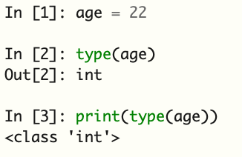
Use the built-in function type()
Printing the output of type(age) above shows us that “age” is not just an int, but it is of type <class ‘int’>. i.e. age is an instance of the ‘int’ class → an object.

Slide 9
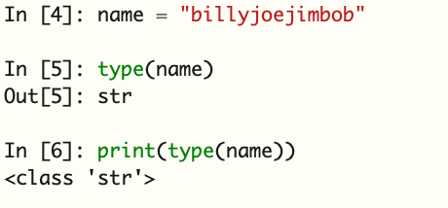
Use the built-in function type()
Printing the output of type(name) above shows us that “name” is not just a string, but it is of type <class ‘str’>. i.e. name is an instance of the ‘str’ class → an object.
You have likely used string “methods” in the past like .upper(), .lower() or .find()

Slide 10
Python is Object Oriented
Everytime you used a string “method” or a list “method” you were using the power of OOP in your programs. Python does not force it upon you but you were using it nonetheless.
This class will not dive into the creation of new Python classes but you will use Python objects of many different class types.

Slide 11
Tracy the Turtle
Turtle Graphics is a Python module that can be imported and used in your programs. Commonly it is called Tracy the Turtle.
When you import the module you are importing the “class” definitions which you can then use to create objects.

Slide 12
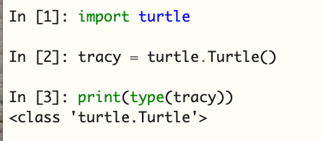
Tracy the Turtle
After importing the turtle module, we can create an instance of the turtle.Turtle() class called “tracy”. “tracy” has all the turtle attributes and methods from the imported class definition.

Slide 13
Lab 2
In Lab 2 you will get comfortable creating and using turtle objects.

Slide 14
Further Resources
https://realpython.com/python3-object-oriented-programming/
https://www.programiz.com/python-programming/object-oriented-programming
https://www.geeksforgeeks.org/python-oops-concepts/

